Slide 1
Intel Maker’s course class 2 – I/Os
Gil Tal.
Aug 2024

Slide 3
Class 2 agenda:
Basics (very basics) electronics – Basic electrical circuit
Ohm law
Basic electronics components
MCU Digital In/Out circuit
MCU Analog in\out
PWM
Different I/Os types

Slide 4
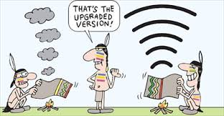


Communication – how it all started …

Slide 5
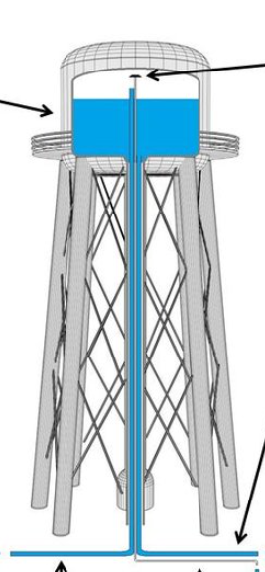
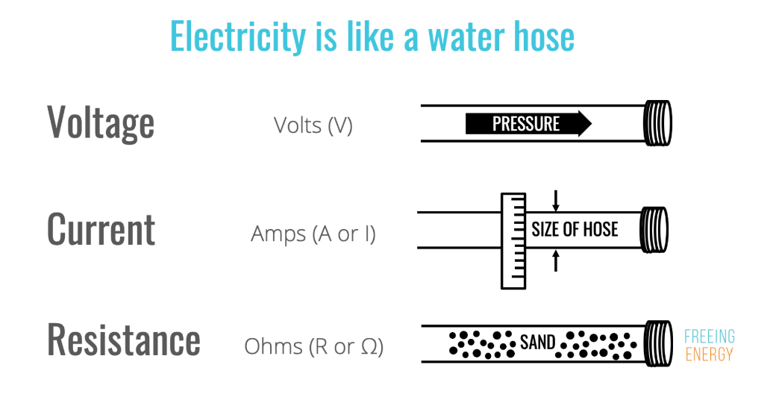
Height (Pressure)
Potential (Voltage)
Ground

Slide 6
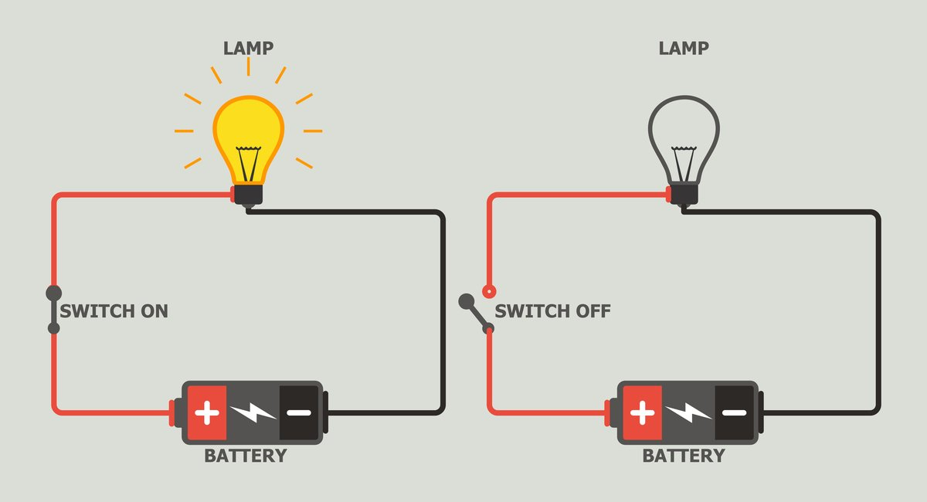
Basic electrical circuit
Basically, we need a power source, which can be a battery for example
We need a consumer – Lamp for example
Once we connect the circuit – current will start flowing and in our example the lamp will turn on

Slide 7
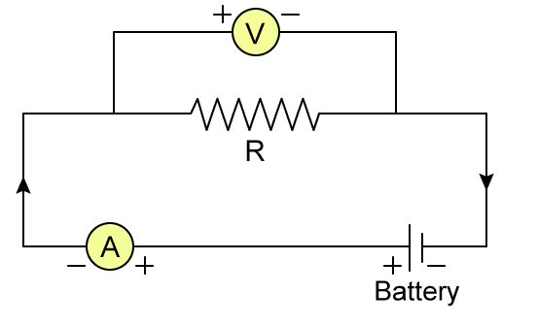
OHM law
V = R*I (URI)
R – represents our consumer
Circled V is a voltmeter – which measures the level of voltage on the consumer R
Circled A is an ampere-meter – which measures the amount of current in flowing in the circuit

Slide 8
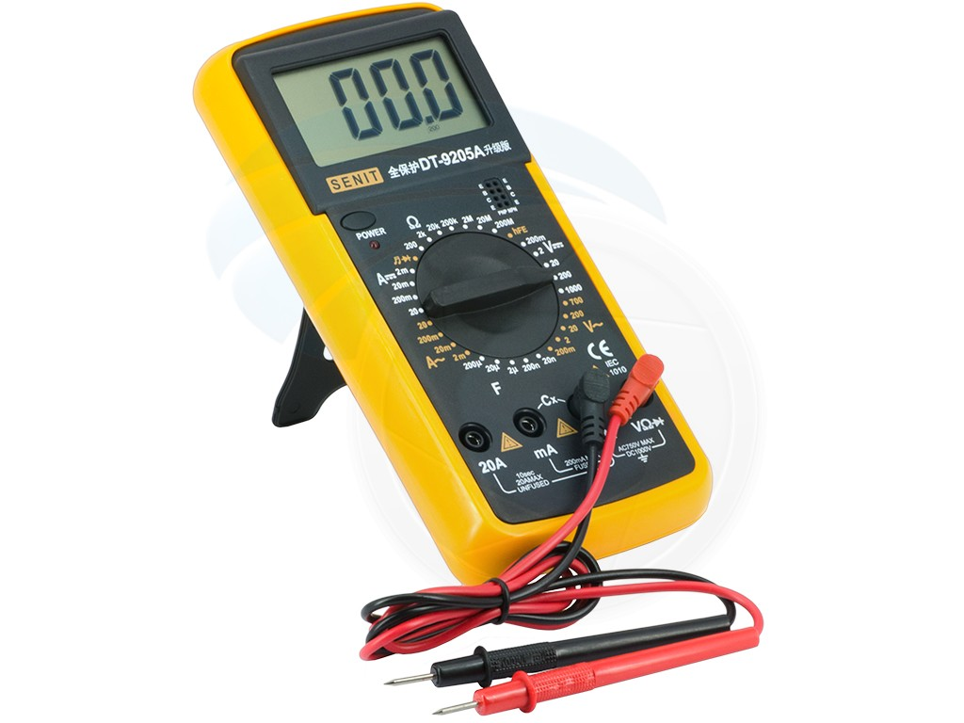
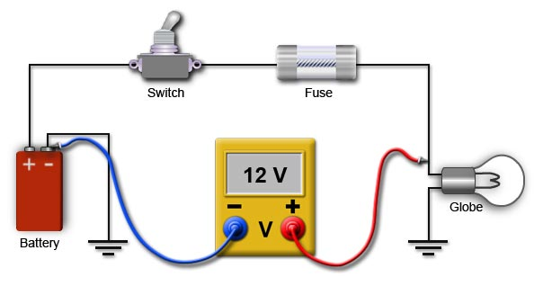
Simple voltmeter
12V

Slide 9
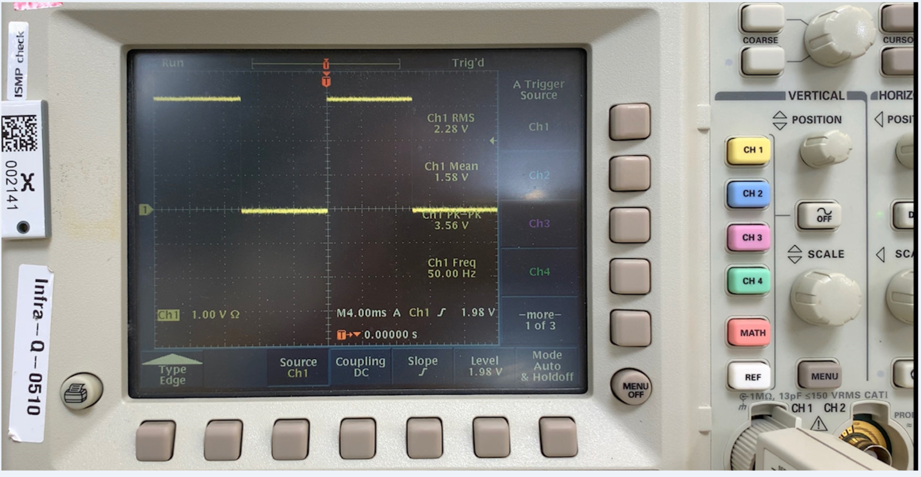
Advanced voltmeter - Scope
Measures the voltage level and display it on a screen constantly
Has advanced features for:
Measure frequency
Triger on event
And more…

Slide 10
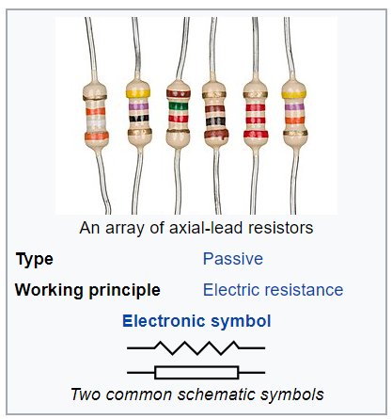
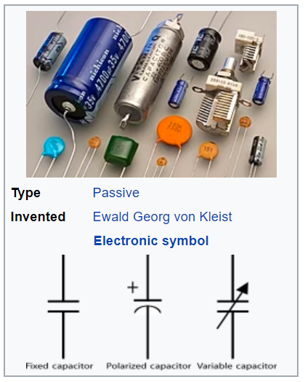
Basic electronics components
A resistor is a passive two-terminal electrical component that implements electrical resistance as a circuit element.
Basically turns electrical energy into heat.
Measure unit: ohm
Usages: Limit current, drop voltage level, Pull up/down floating signals
A capacitor is a device that stores electrical energy in an electric field. It is a passive electronic component with two terminals.
Measure unit: Farad
Usages: Handle power supply surge, very fast absorption of electrical energy (also fast discharge), along with a resistor a simple reset at power on

Slide 11
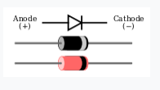
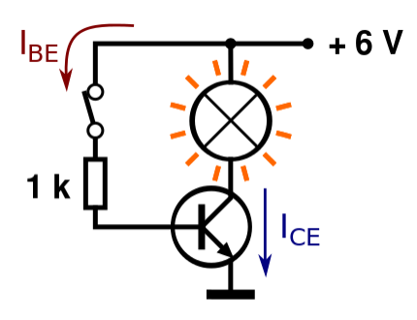
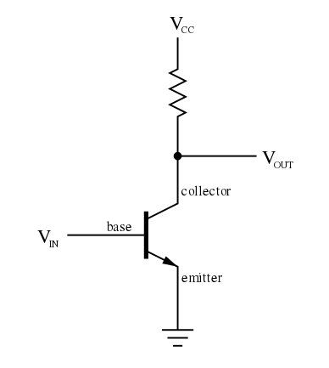
A diode is a two-terminal electronic component that conducts current primarily in one direction (asymmetric conductance); it has low (ideally zero) resistance in one direction, and high (ideally infinite) resistance in the other.
A transistor is a semiconductor device used to amplify or switch electronic signals and electrical power

Slide 12
MCU Digital In/Out circuit

Slide 13
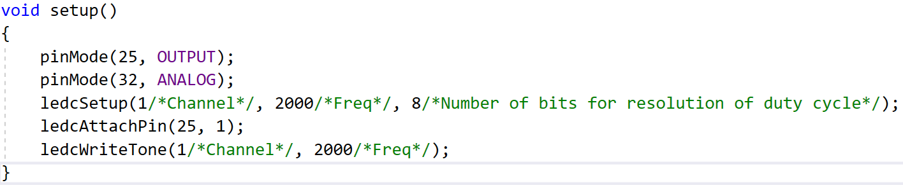
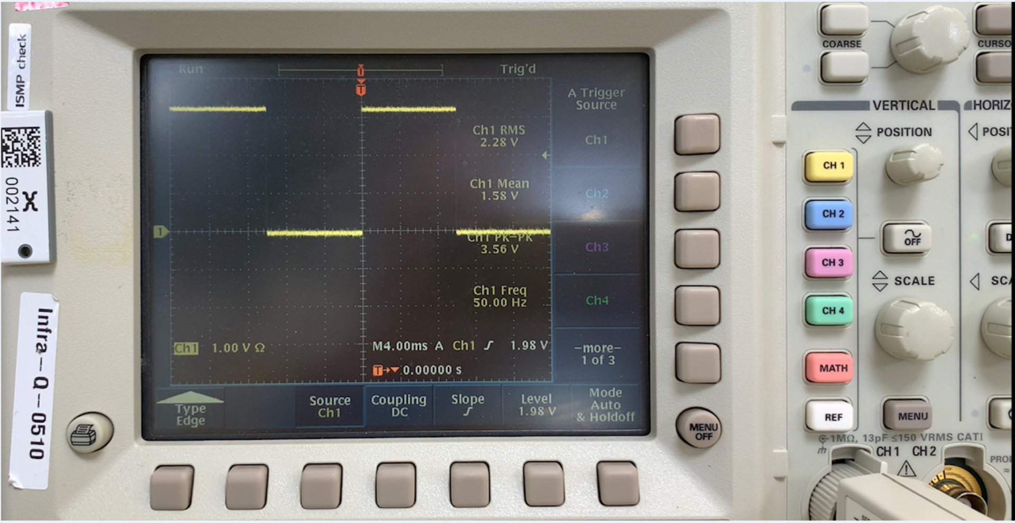
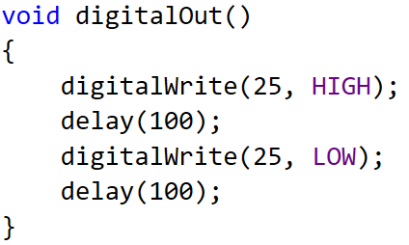
Digital OUT on the Scope

Slide 14
MCU Analog Input\Output

Slide 15
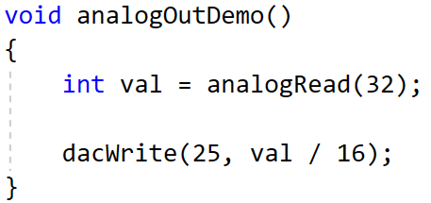
MCU Analog In/Out

Slide 16
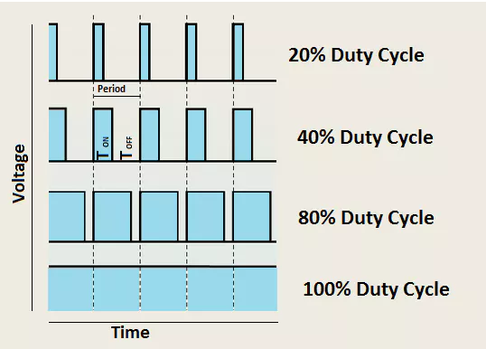
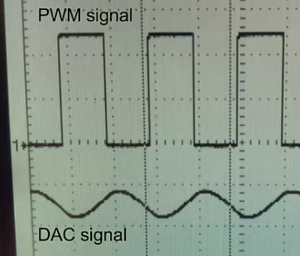
MCU PWM - Pulse-width modulation
Enable us to generate a square waveform @ 0 – 65KHz
We can control the duty cycle of the generated waveform
Can be used to:
Generate music ☺
Control the luminance of a LED matrix
Control the speed of a DC motor

Slide 17
Communication between two devices
Very simple way to start communicating….
From basic messages to complex protocols
Many I/Os can used
I2C, UART and SPI are common and simple examples

Slide 18
Complete LED Circuit

Slide 19
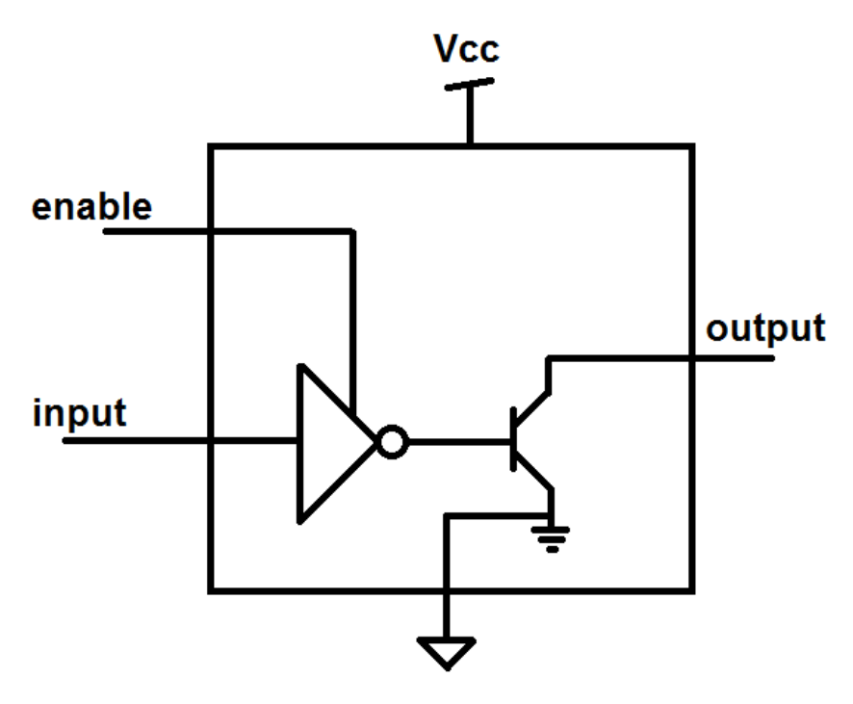
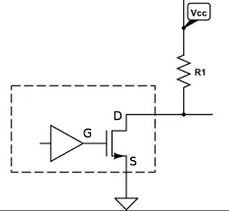
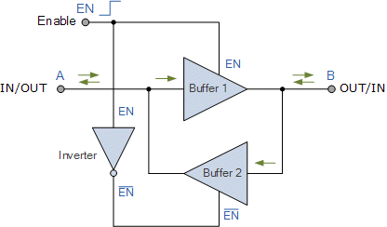
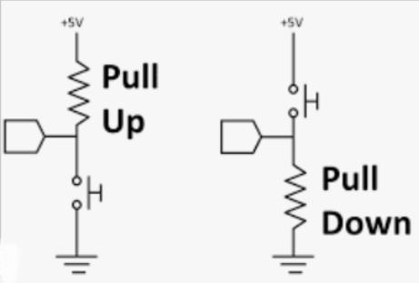
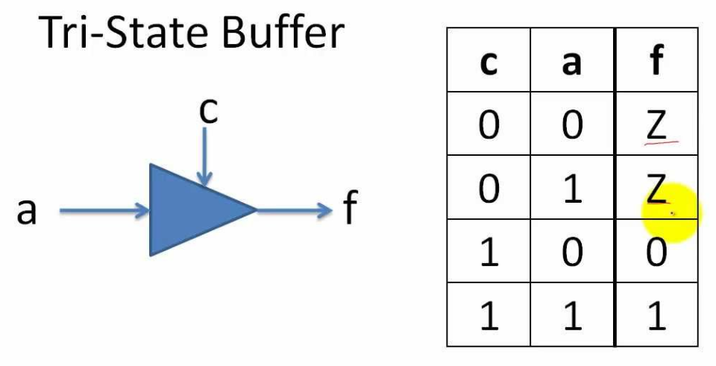
Open drain buffer: Either short to ground or float the output
A pull up resistor is needed to drive logic 1!
Bi-Directional I/O
Tri state buffer:

Slide 20
Using the different types of I/Os in Arduino
Digital type:
Setup: pinMode(34 /* IO Number */, INPUT);
Setup: pinMode(34 /* IO Number */, OUTPUT);
digitalWrite(34, HIGH); digitalWrite(34, LOW);
digitalRead(34);
Analog type:
Setup: pinMode(36, ANALOG) // Input only
analogRead(36);
PWM (Pulse-Width Modulation) ESP32:
Setup: pinMode(25, OUTPUT);
Setup: ledcSetup(1/*Channel*/, 2000/*Freq*/, 8/*Number of bits for resolution of duty cycle*/);
Setup: ledcAttachPin(25, 1);
ledcWriteTone(1/*Channel*/, 2000/*Freq*/);
ledcWrite(1/*Channel*/, 196 /*Duty Cycle*/);
DAC:
No setup needed
dacWrite(25,Value /* 0 – 255 */); // Output 0-3.3V, 0.013V steps

Slide 21
PWM on ESP32 (16 Channels)
HW mechanism
Channel 0
I/O
Set as Output
Frequency
0-64K
PWM (Pulse-Width Modulation) ESP32:
Setup: pinMode(25, OUTPUT);
Setup: ledcSetup(1/*Channel*/, 2000/*Freq*/, 8/*Number of bits for resolution of duty cycle*/);
Setup: ledcAttachPin(25, 1);
ledcWriteTone(1/*Channel*/, 2000/*Freq*/);
ledcWrite(1/*Channel*/, 196 /*Duty Cycle*/);
Duty Cycle control
0-100%
Channel N
I/O
Set as Output
Frequency
0-64K
Duty Cycle control
0-100%
Channel 15
I/O
Set as Output
Frequency
0-64K
Duty Cycle control
0-100%

Slide 22
I/Os setup:
Digital type:
Setup: pinMode(34 /* IO Number */, INPUT);
Setup: pinMode(34 /* IO Number */, OUTPUT);
Setup: pinMode(34 /* IO Number */, INPUT_PULLUP);
Setup: pinMode(34 /* IO Number */, INPUT_PULLDOWN);
Setup: pinMode(34 /* IO Number */, OUTPUT_OPEN_DRAIN);
digitalWrite(34, HIGH);
digitalWrite(34, LOW);
digitalRead(34);
Analog type:
Setup: pinMode(36, ANALOG) // Input only
analogRead(36);

Slide 23
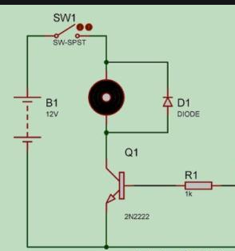
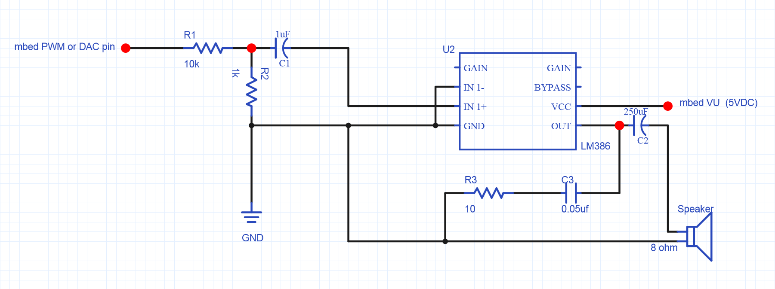
Usage for i/os
Digital: Control led, relays, read state of digital inputs coming from different devices
Analog: Read voltage level of a device, potentiometer, Joy Stick
PWM: Control a speaker, DC motors, servo electric engines and more…
DAC: Drive a speaker with volume control, generate special wave forms, use your imagination (TV out)
PWM

Slide 24
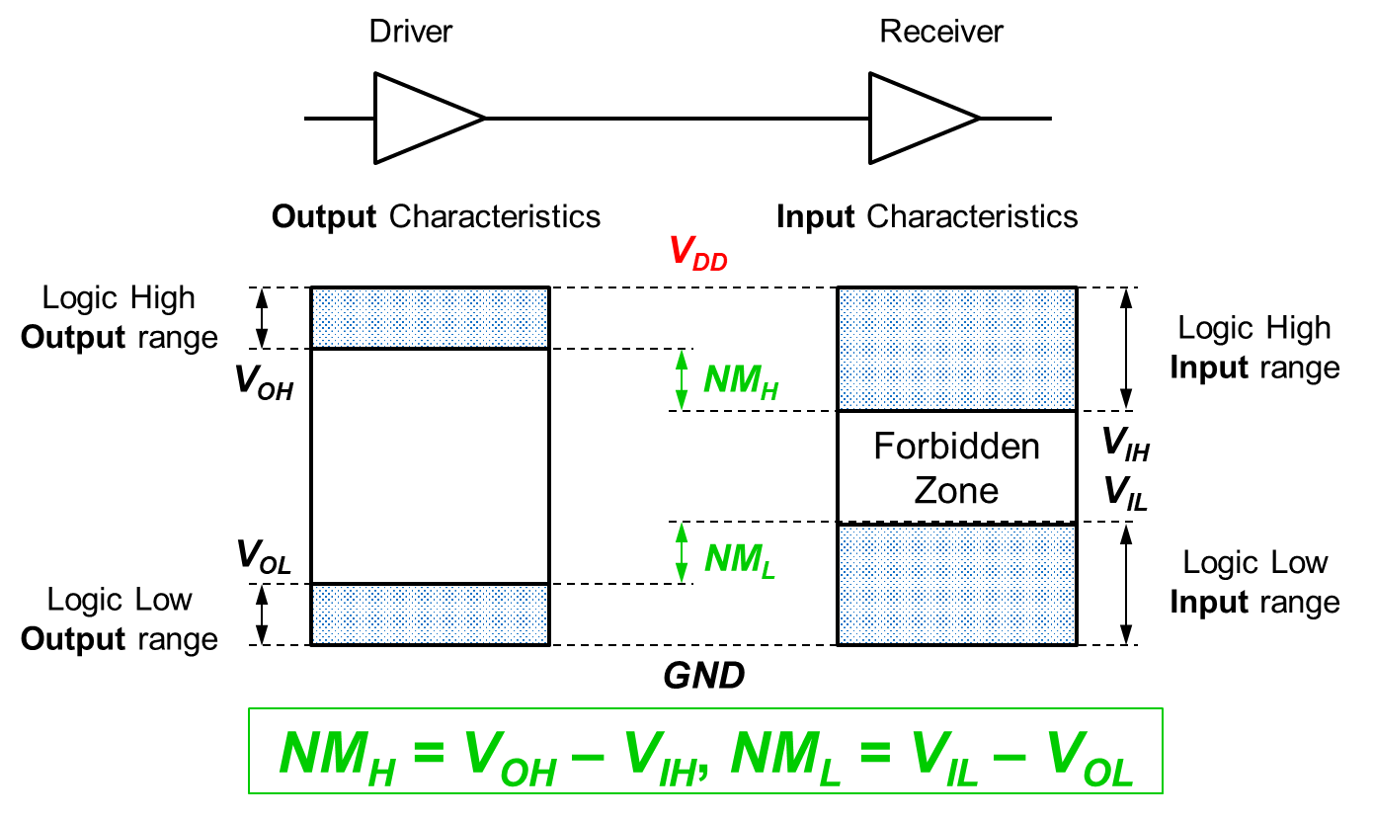
Voltage levels for decoding digital 0 or 1

Slide 25
I/O matrix and device mapping
Some units have fixed IO mapping
Most micro controllers have IO matrix for greater flexibility
Some options might have frequency limitations

Slide 26

Basic rules
Output must not be connected to another output!
Floating signals can cause unexpected results of even damage
Two sides of a communication channel:
Must have same reference (GND)
“Talk in the same voltage levels”*
Distance have an effect on the signal quality

Slide 27
Before connecting a device…
We need to figure out:
Physical connection (either by watching the schematic, detailed board diagram or any other document with the relevant data)
What interface\protocol is used by the device, need to make sure we have a free one
What is the frequency the device can operate
Voltage level – both I/O and supply
Total power consumption
Does it have additional signals needed beside what the protocol defines
Does it need a pull up or pull down on part of the signals?

